Slide 1
Oil Pollution Module for Mariners
Created by Capt. Walt Nadolny, SUNY Maritime College,
Department of Marine Transportation
Funded by a grant from The National Fish and Wildlife Foundation

Slide 2
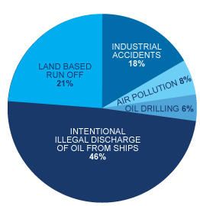
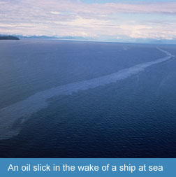
We, as mariners are a significant source of the problem
Source: American Academy of Sciences,
Oil in the Sea III, 2003

Slide 3
International Convention for the Prevention of Pollution from Ships (MARPOL)
MARPOL was written in 1973 and revised in 1978 by the International Maritime Organization (IMO)
The main international convention covering prevention of pollution of the marine environment by ships from operational or accidental causes.
The MARPOL Convention was adopted on 2 November 1973 at IMO. The Protocol of 1978 was adopted in response to a spate of tanker accidents in 1976-1977.

Slide 4
MARPOL – The Six Annexes

Slide 5
ANNEX I
OIL

Slide 6
ANNEX I
Oil tankers transport some 2,400 million tons of crude oil and oil products around the world by sea.
Measures introduced by IMO have helped ensure that the majority of oil tankers are safely built and operated and are constructed to reduce the amount of oil spilled in the event of an accident
Operational pollution, such as from routine tank cleaning operations, has also been cut.

Slide 7
U.S. FEDERAL LAWS
Key Marine Oil Pollution Laws in the United States

Slide 8
Act To Prevent Pollution From Ships -APPS-
Passed by Congress in 1980
US law that implements MARPOL
It makes it a crime to knowingly violate the oil pollution provisions of MARPOL.

Slide 9
Key Provisions To Apps
Requires that oily waste water on ships be processed by a properly working oily water separator and oil content monitor and that any discharge contains no more than 15 parts per million of oil
Requires that all discharges be accurately recorded in an oil record book

Slide 10
Oily Water Separator
Engine departments produce oil-contaminated bilge waste when water mixes in the bottom of the vessel, known as the bilges, with oil that has leaked from machinery, engines, and lubrication or fuel systems.
oily mixtures must be collected and stored in tanks. They can also be processed on-board to separate the water from the oil using a pollution-prevention device known as an Oily Water Separator.
Notes:
----- Meeting Notes (6/25/12 21:24) -----
EDIT

Slide 11
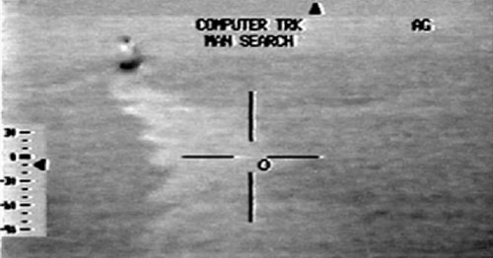
SATTELITE IMAGERY OF SHIP RELEASING OIL AT NIGHT

Slide 12
How It Works…
After passing through the Oily Water Separator, bilge waste water containing fifteen parts per million or less of oil may be discharged overboard
When properly installed and used, a sensor in the Oil Content Monitor detects the presence of oil in concentrations greater than 15 parts per million and automatically shuts down any overboard discharge
It should also sound an audible alarm in the engineering room

Slide 13
OIL RECORD BOOK
ALERT! Maintaining a false oil record book and lying to US Coast Guard officials is one of the most common charges brought against polluting ships. Lying to a Coast Guard officer, presenting a falsified oil record book, hiding evidence, or telling seafarers not to tell the truth can all be felony offenses and can lead to heavy fines and imprisonment.
Notes:
----- Meeting Notes (6/25/12 21:24) -----
EDIT

Slide 14
How It Works…
Every disposal of oil residue and oily mixtures, slops from bilges, and oily bilge water should be recorded in this book. The disposal of oil residue and oily mixtures, slops from bilges, and oily bilge water should be recorded in this book.
Full and accurate notes must be kept about the discharge of this material overboard, by incineration, or by other forms of disposal without delay by the person in charge of the operations.

Slide 15
Types Of Penalties
INDIVIDUAL
CORPORATION
Violating APPS is a class D felony. Individuals can receive a fine to up to $200,000 per count or up to twice the gross gain or loss from the offense. Individuals can also be imprisoned for up to six years.
Corporations that violate APPS can face fines of up to $500,000 per count or up to twice the gross gain or loss from the offense.

Slide 16
THE CLEAN WATER ACT To keep this….

Slide 17
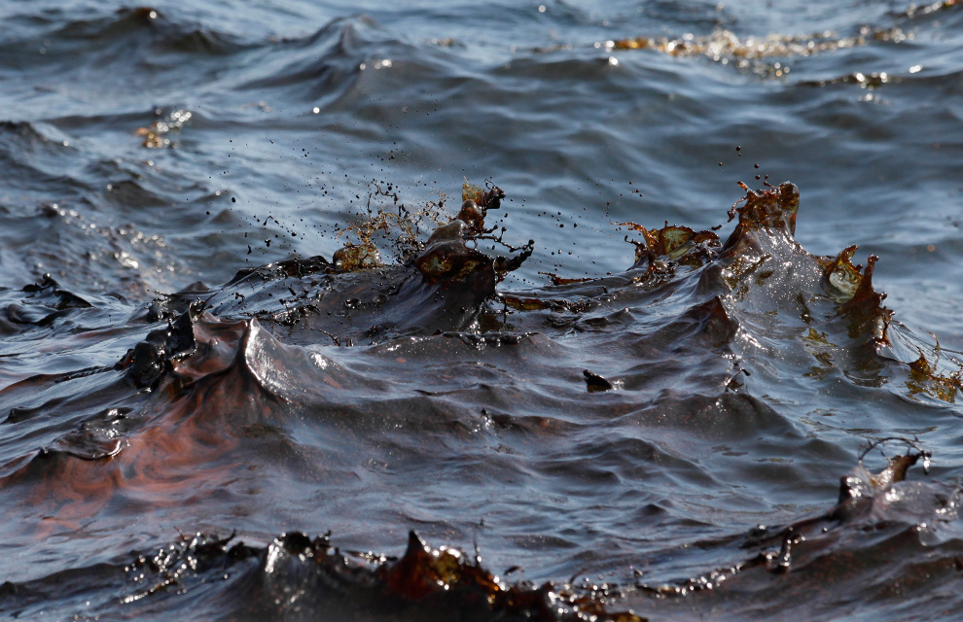

Slide 18
From happening.

Slide 19
Clean Water Act/ Oil Pollution Act Of 1990
Passed in 1972 to protect fish and wildlife by ensuring water quality
Addresses oil pollution and bans any discharge of oil into the navigable waters of the US or any waters that affect natural resources in the US exclusive economic zone in harmful quantities
The Clean Water Act was amended by the Oil Pollution Act of 1990 following the devastation of the Exxon Valdez oil spill in Alaska

Slide 20
Key Provisions
It is a crime to negligently or knowingly discharge a “harmful quantity” of oil into US waters.
Failing to report an oil spill to the government is also a crime. Any “person in charge” on a vessel that has discharged oil must immediately report the spill to the National Response Center.
NRC 1800 (424 8802 )

Slide 21
Types Of Penalties
INDIVIDUAL
CORPORATION
Individuals who fail to notify the federal government about an oil spill or discharge can be fined up to $200,000 or up to twice the gross gain or loss and may be imprisoned for up to 5 years
A negligent violation of the Clean Water Act is a misdemeanor and can result in up to one year in prison
A knowing failure to report a spill or a leak is a felony and can result in up to 5 years in prison
Corporations can be fined up to $500,000 and up to twice the gross gain or loss for failing to notify a federal agency
Ship owners are also responsible for the cost of any damages caused by the oil and any removal costs

Slide 22
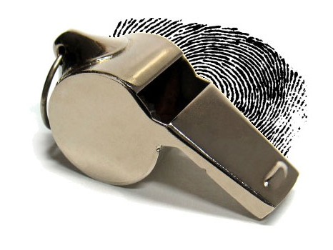
Whistleblowers

Slide 23
Some Facts…
In 2001, there were roughly 88,000 ships over 100 gross tons registered to operate as part of the global commercial fleet. Of these ships, it is estimated that ten to fifteen percent regularly break the law and intentionally dump oil into the seas
More than half of all MARPOL cases occur as a result of crewmembers alerting US authorities about illegal discharges or false records

Slide 24
More Facts…
33 U.S.C, Section 1908 a), individuals involved in reporting a violation that leads to a conviction are eligible to receive up to half of the fine incurred by the company
In the past three-and-a-half years, over one third of maritime prosecutions have resulted in awards to whistleblowers, ranging from $40,000 to $400,000

Slide 25
Major Whistle Blower Cases
CASES:
US V. ILIOS SHIPPING COMPANY
US V. IONIA MANAGEMENT
US V. GENERAL MARITIME MANAGEMENT
US V. OVERSEAS SHIPHOLDING GROUP, INC.
US. V. WALLENIUS SHIP MANAGEMENT
US. V. OMI CORPORATION

Slide 26
US V. ILIOS SHIPPING COMPANY
The Report: A crew member emailed a letter, photographs, and a video to the Coast Guard that described and showed the illegal discharge setup
The Crime: Failure to maintain an accurate oil record book.
Penalty: Ilios Shipping Company paid a $2 million penalty

Slide 27
Whistleblower awarded…
$
350,000

Slide 28
US V. IONIA MANAGEMENT
The Report: The Coast Guard received a report from the Kriton’s electrician that the ship, then berthed at the Magellan Terminal in the Port of New Haven, had been discharging oily bilge water directly overboard through a bypass hose
The Crime: Thirteen counts of violating the Act to Prevent Pollution from Ships, three counts of falsifying records in a federal investigation, one count of obstruction of justice, and one count of conspiracy
The Penalty: Ionia Management paid a $ 4.9 million penalty
Three Whistleblowers awarded…

Slide 29
500,000
350,000
350,000
$
$
$

Slide 30
US V. OVERSEAS SHIPHOLDING GROUP, INC.
The Crime: Thirty-three felony convictions in six different judicial districts, including violations of the Clean Water Act, Oil Pollution Act, the Act to Prevent Pollution from Ships as well as conspiracy, false statements, and obstruction of justice
The Report: A fitter of the M/T Uranus, a fourth engineer on the M/T Alcesmar, a second engineer and third engineer and two oilers of the M/T Pacific Ruby alerted officials of discharged sludge and oily waste and deliberately concealed pollution through the use of false oil record books and tampering with anti-tricking equipment
Penalty: Overseas Shipholding Group, Inc. paid a total of $37 million dollars, the largest-ever criminal penalty involving deliberate vessel pollution

Slide 31
12 Whistleblowers were awarded…
$
437,5000
EACH

Slide 32
HOW TO REPORT A SPILL
All oil or chemical spills, maritime safety incidents, and criminal dumping must be reported to the federal government’s National Response Center
NRC 1-800-424-8802
New Jersey Department of Environmental Protection hotline - 1-877-WARNDEP (1-877-927-6337)
New York the Department of Environmental Conservation’s hotline - 1-800-457-7362 (within NY State) or 518- 457-7362 (outside NY State)
KEEP THESE NUMBERS HANDY

Slide 33
Whistleblowers should inform US Coast Guard investigators of their findings during routine port inspections. Whistleblowers are encouraged to provide evidence in the form of photos or video recordings

Slide 34
Something to keep in mind. Any Flag State that is a signatory of MARPOL can prosecute any vessel regardless of flag for violations of MARPOL. Neither you nor your vessel has immunity.

Slide 35
Additional Resources marinedefenders.com IMO.org www.uscg.mil/npfc/laws_and_regulations.asp

Slide 36
Project Overview
What is Marine Defenders?
An educational program designed to reduce chronic oil pollution
What should the Professional Mariner get from this project?
The skills and understanding to report and prevent chronic oil pollution
For further materials please contact:
Capt. Walt Nadolny
wnadolny@sunymaritime.edu

