Slide 1
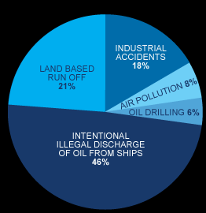
Sources of Oil in Water
Notes:
An estimated 5 -15% of the commercial vessels at sea dump illegally – and their waste is responsible for nearly half of all the oil entering the waters from human sources.
The yearly intentional discharge of oil into the seas through routine shipping operations is equal to eight times the amount released by the Exxon Valdez oil spill.

Slide 2
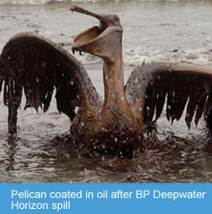
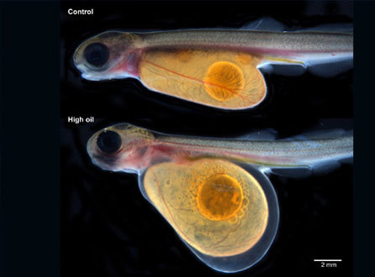
Oil and Organisms
Oil is toxic.
Birds’ feathers rapidly absorb oil decreasing their insulating, buoyancy, and waterproofing capabilities.
Oil exposure to eggs decreases hatch rates, and increases deformities, and causes behavioral changes.
Fish that are exposed to oil often develop fin erosion, skin sores, liver damage, and cancer, and they can also bioaccumulate dangerous chemicals.
Photo Credit: Charlie Riedel, AP
Photo Credit: Mark Carls, NOAA

Slide 3
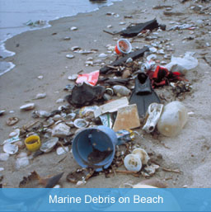
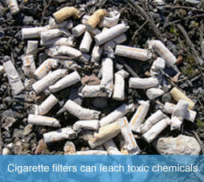
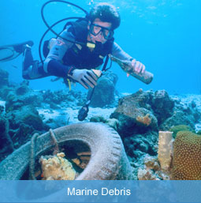
Marine Debris
Marine debris is any man-made solid that finds its way into the water.
Plastic items are the most common type of marine debris. Fishing gear, food packaging, glass, metal, medical waste, and cigarette filters are other common types of marine debris.
Cigarette filters release carcinogens and other toxic chemicals when in the ocean.
Photo credits top to bottom: Ocean Conservancy, Ocean Conservancy, Lamoit

Slide 4
Laws and Treaties
MARPOL 73/78 is an international treaty governing marine pollution.
136 countries have signed the MARPOL convention.
US Clean Water Act/Oil Pollution Act 1990
US Act to Prevent Pollution from Ships (APPS) 1980
US Ports and Waterways Safety Act of 1972
Whistleblowers are entitled to a portion of the fines against oil polluters

